Slide 1
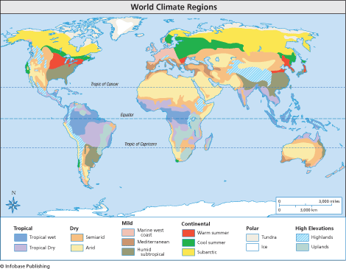
Climate Controls
Ms. Bankoff

Slide 2
Learning Objectives
Students will understand the difference between weather and climate.
Students will understand some of the factors that affect climate.

Slide 3
Climate Vocabulary
Weather - describes the atmospheric conditions at a specific place at a specific point in time. generally described in short time frames - minutes, hours, days, and weeks.
Climate – the average weather conditions of an area. Generally describes the average for weather over a period of months, years, decades, or longer.
Types of Climates - based on average yearly temperatures and precipitation

Slide 4
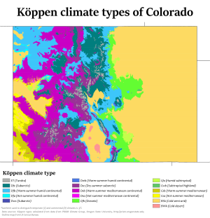
Type of Climate - Denver
The Eastern Plains region's climate consists of low humidity, plentiful sunshine and little precipitation year round. There is a large temperature range from day to night and between seasons.
Notes:
While it's fairly easy to describe a location's climate by examining weather data, a greater challenge is figuring out why the climate of one place differs from that of another. To do so, you must consider all the factors that work together to determine climate. Today, we are going to look at a number of factors that influence climate.

Slide 6
Climate Controls
Latitude
Elevation
Nearby Water
Ocean Currents
Topography
Vegetation
Prevailing Winds
Source: https://www.classzone.com/books/earth_science/terc/content/investigations/es2101/es2101page02.cfm?chapter_no=investigation

Slide 7
Latitude & Solar Radiation
Animation of net radiation by month
https://earthobservatory.nasa.gov/GlobalMaps/view.php?d1=CERES_NETFLUX_M
Describe what’s going on in the animation.
Propose a reasons why that’s happening.

Slide 8
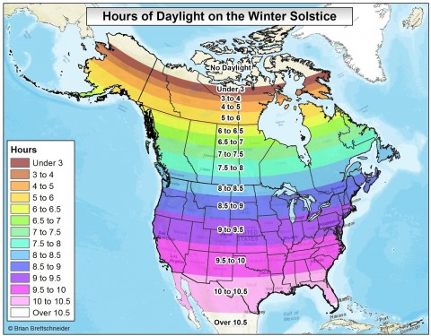
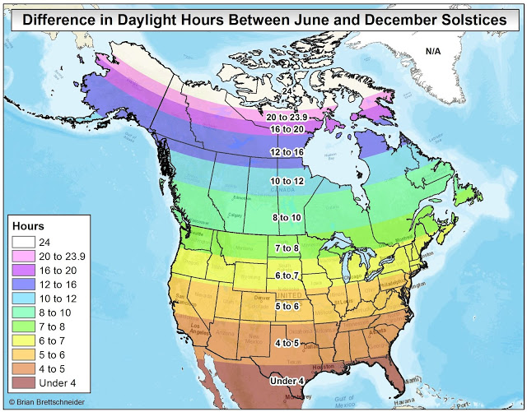
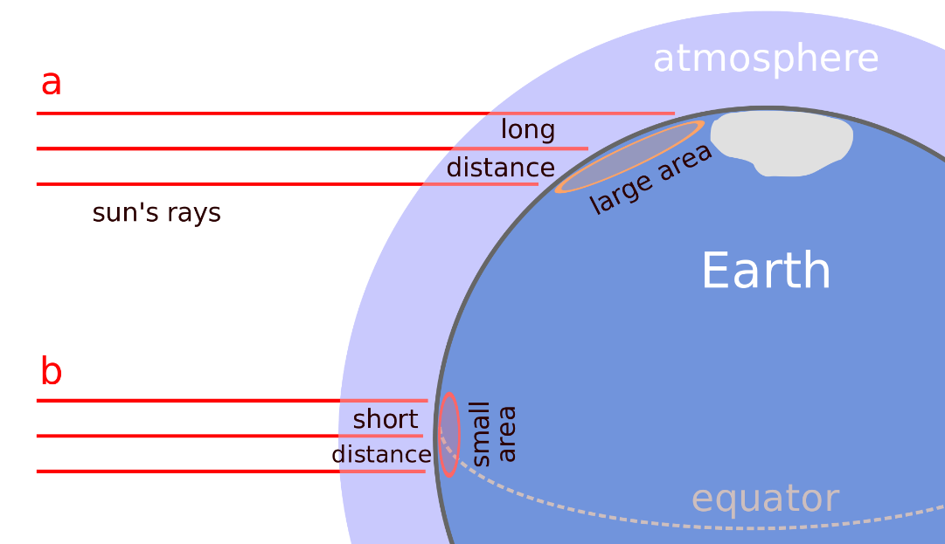
Latitude - Distance from the equator
Angle of sunlight – high latitudes the light is less concentrated and more spread out
Hours of Daylight – High latitudes have greater variability in the number of hours of sunlight received

Slide 9
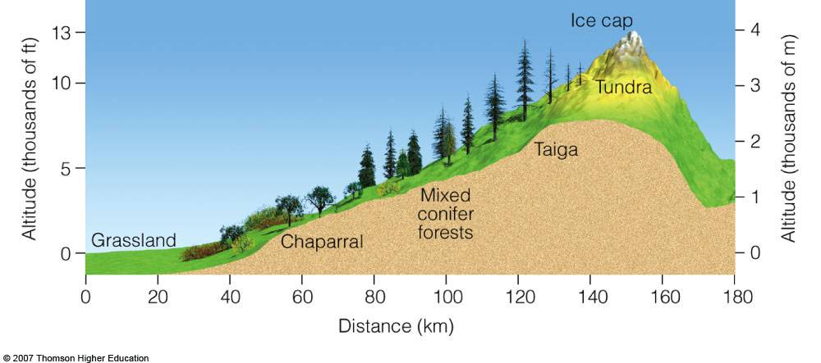
Elevation - Height above sea level
Lapse Rate ≈ -3.5°F per 1000 feet up
Notes:
Normally, climatic conditions become colder as altitude increases. “Life zones” on a high mountain reflect the changes, plants at the base are the same as those in surrounding countryside, but no trees at all can grow above the timberline. Snow crowns the highest elevations.

Slide 10
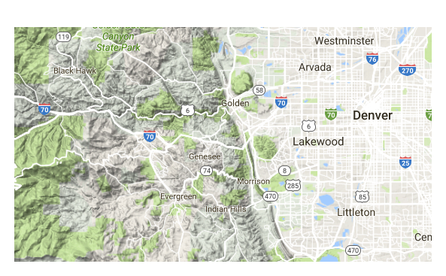
Elevation
Evergreen = 7280
Denver = 5280
Difference = 2000 ft
Difference in temperature? (Remember, Lapse Rate)
2 x -3.5°F = -7°F
If it’s 80°F in Denver, it’s probably 73°F in Evergreen!
Notes:
Lets look at an example here in Colorado. Evergreen’s Elevation ** is about 7280 and it’s neighbor, Denver is out here on the plains. ** Its elevation is only 5280, the mile high city. That’s a difference of about 2000 ft elevation. How many degrees difference would you expect to see between Evergreen and Denver on a given day? **we just mentioned the lapse rate.. For every thousand feet of elevation gained, the temperature drops 3.5°F. Here’s how we would do the math. ** Since we gain 2 thousand feet to go from denver to Evergreen, we multiply the lapse rate times two. We would expect to see a 7°F difference between evergreen and denver. What that means is that if it’s 80 in denver, ** its probably 73 degrees in evergreen!

Slide 11
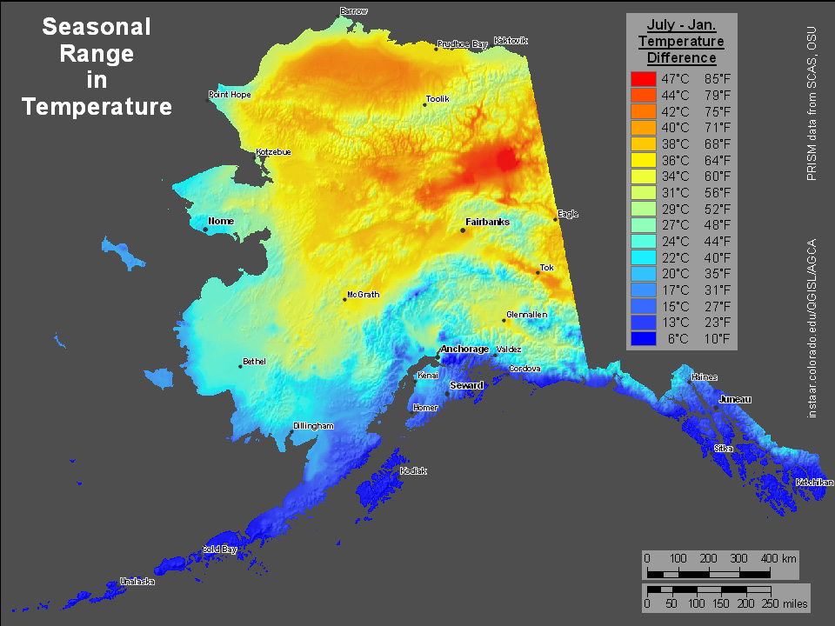
Nearby Water
Water takes a long time to heat up.
Water retains heat very well.
Continental City
High Variation (Changes a lot)
Maritime City
Low variation
(Doesn’t change much)

Slide 12
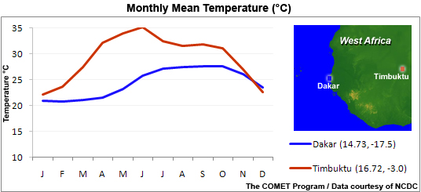
Nearby Water
?
Which city is continental? Which is maritime?
How do you know?

Slide 13
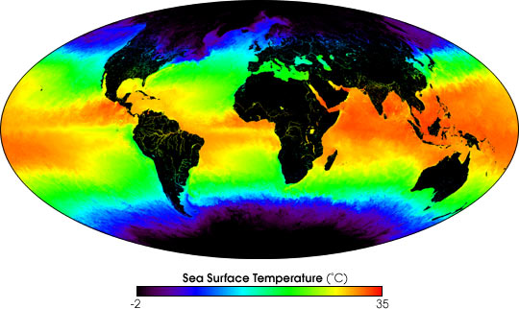
Ocean Currents
Solar radiation warms the water around the equator.
Water moves around, carrying energy from place to place.

Slide 14
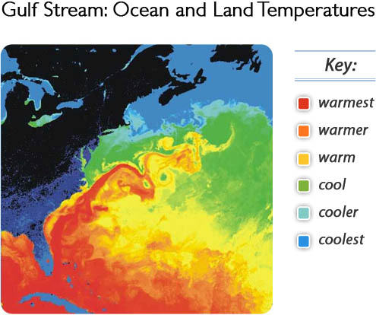
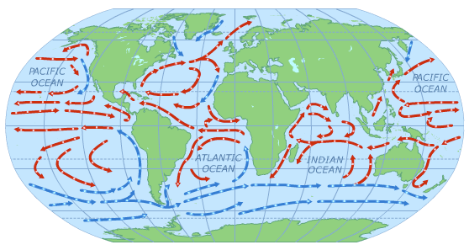
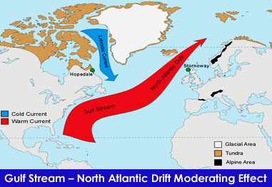
Ocean Currents
Climate of a place near a tropical current is warmer than it would be without it.

Slide 15
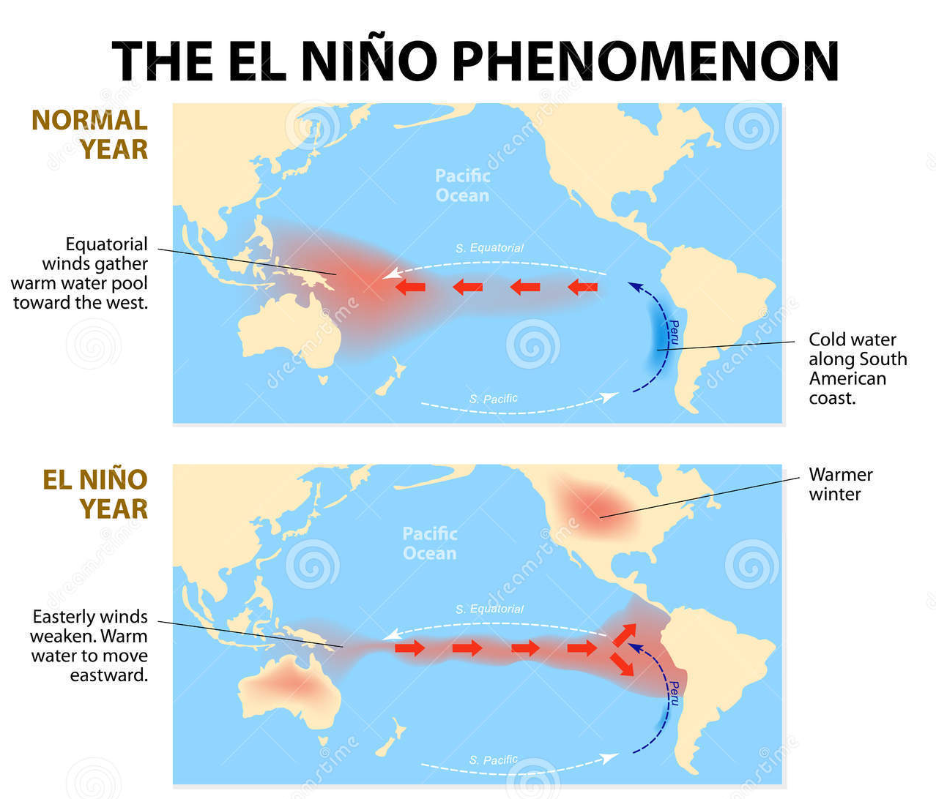
Ocean Currents
Chris Farley: https://www.youtube.com/watch?v=mkSRUf02gu8

Slide 16
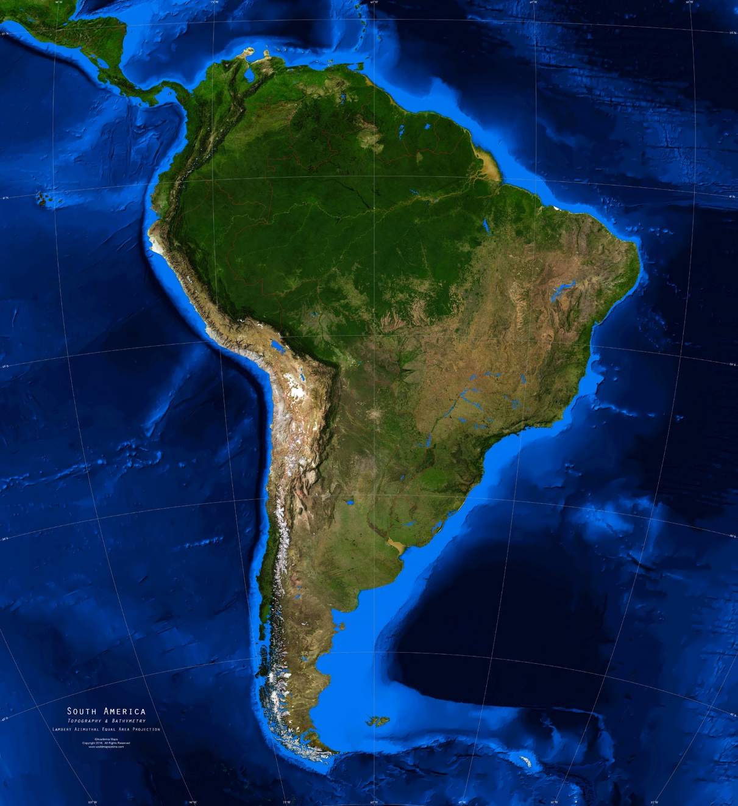
Topography
Atlantic Ocean
Where do the winds come from?
How much moisture/warmth do they carry?
Amazon Rainforest
Atacama Desert

Slide 17
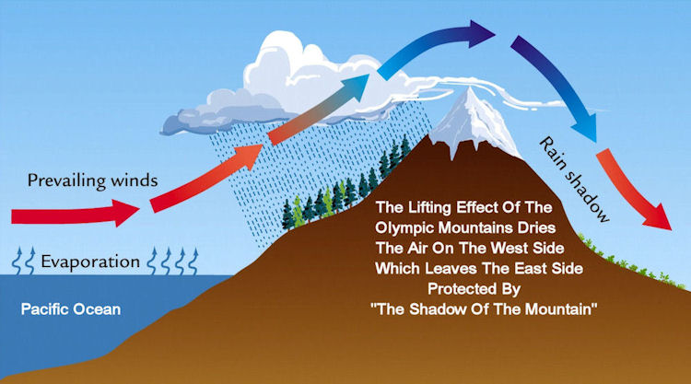
Topography
Rising air = precipitation
Sinking air = clear skies

Slide 18
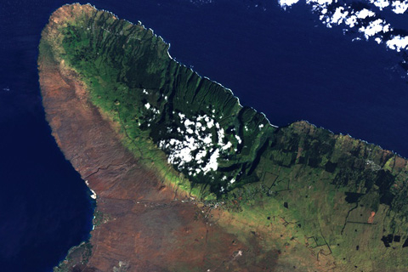
Topography
Draw the direction of the prevailing wind?

Slide 19
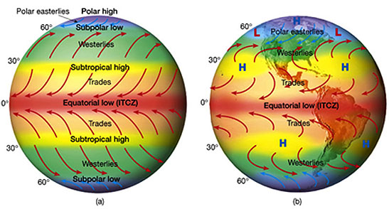
Prevailing Winds

Slide 20
Prevailing winds animation
Sinking air = clear skies
Rising air = precipitaiton
https://earthobservatory.nasa.gov/GlobalMaps/view.php?d1=TRMM_3B43M

Slide 21
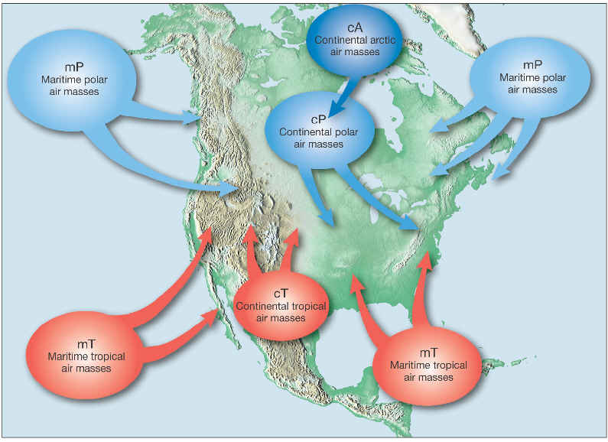
Prevailing winds

Slide 22
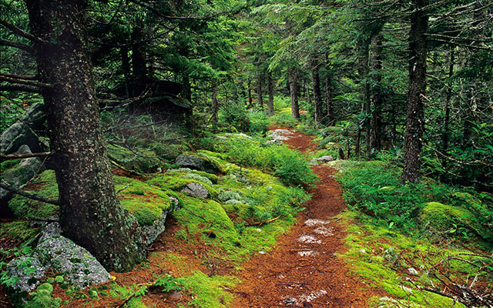
Vegetation
Transpiration- when leaves lose water to evaporation
Vegetation & Precipitation animation:
https://earthobservatory.nasa.gov/GlobalMaps/view.php?d1=TRMM_3B43M&d2=MOD13A2_M_NDVI

