Slide 1
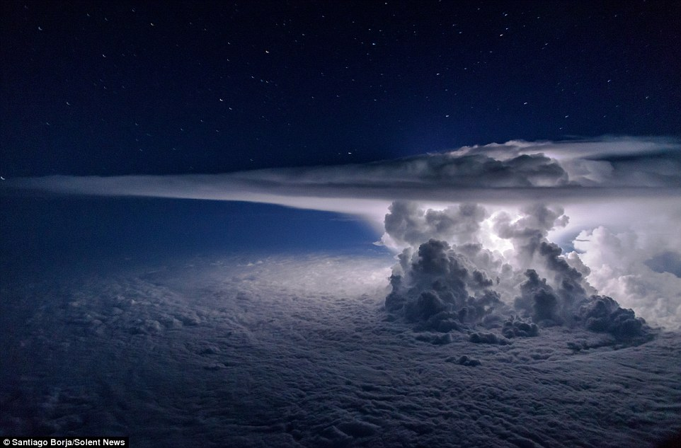
Feedback and Climate

Slide 2
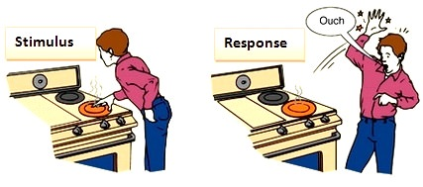
Stimulus & Response
Stimulus = a thing or event that evokes a specific response.
Find the STIMULUS…
https://www.youtube.com/watch?v=_mebt0MlXDc
What was your response?

Slide 3
FEEDBACK LOOPS
Negative feedback is when the response diminishes the original stimulus. System is stabilized.
Positive feedback is when the response enhances the original stimulus. System changes over time.

Slide 4
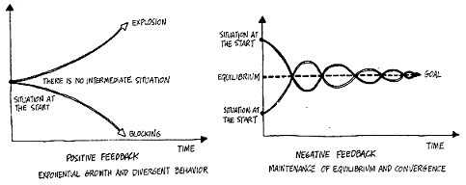
FEEDBACK LOOPS

Slide 5
FEEDBACK LOOPS ANOTHER WAY TO VISUALIZE IT

Slide 6
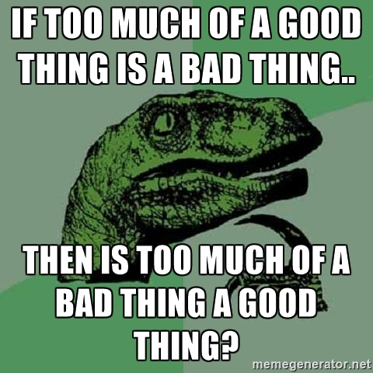
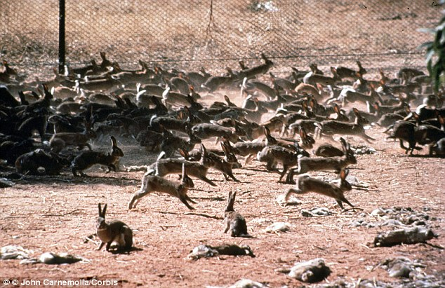
Positive feedback is less common,
which is understandable, as most changes to steady state pose a threat, and to enhance them would be most unhelpful.
Too few
Too many

Slide 7
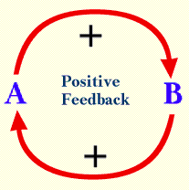
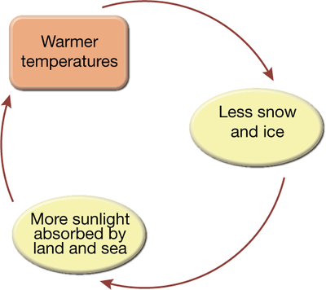
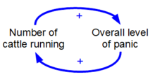
Positive Feedback Loops
Response strengthens initial stimulus – Response gets greater and greater or smaller and smaller over time

Slide 8
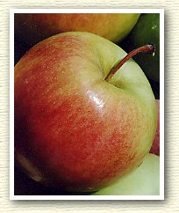
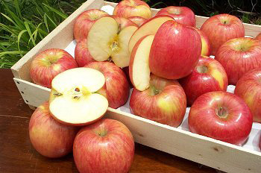
Examples of Positive Feedback
Ripe fruit produces more ethylene
Ethylene makes fruit ripen

Slide 9
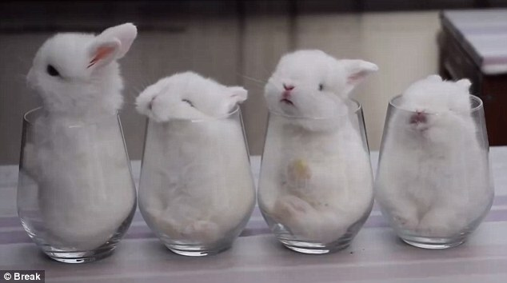
Negative feedback is most common in biological systems.
Conditions stay
within a small range.
Just right

Slide 10
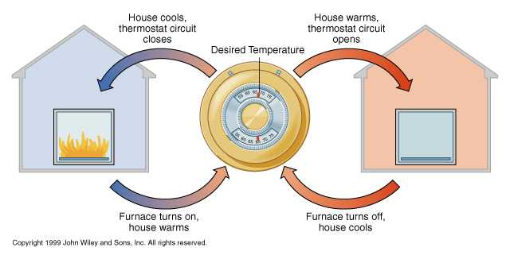
Negative Feedback
Keeps the temp in your house in a SMALL range. Stabilizes!

Slide 11
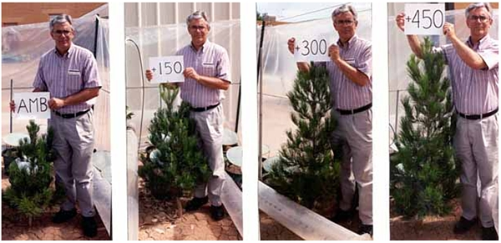
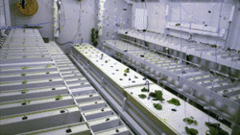
Negative Feedback Loop
Added CO2 in the atmosphere
Increase in plant growth (photosynthesis)
Plants remove CO2 from atmosphere
System is stabilized. Amount of CO2 in the air remains the same over time.

Slide 12
Negative Feedback Loops: Predator-Prey Relationship
More antelope
Cheetah pop grows
Stable population of antelope
Fewer antelope
Cheetah pop shrinks

Slide 13
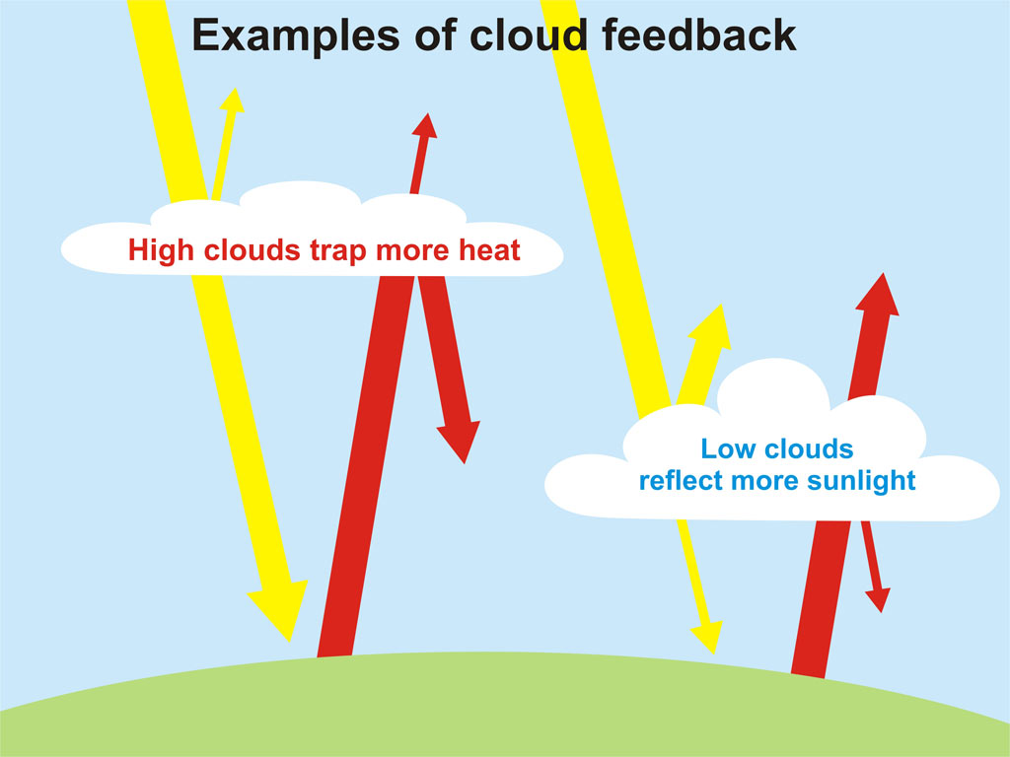
Big Picture: Climate science is complicated!
Positive and negative feedback loops are acting simultaneously.
Making predictions about future climate conditions is very difficult.

Slide 14
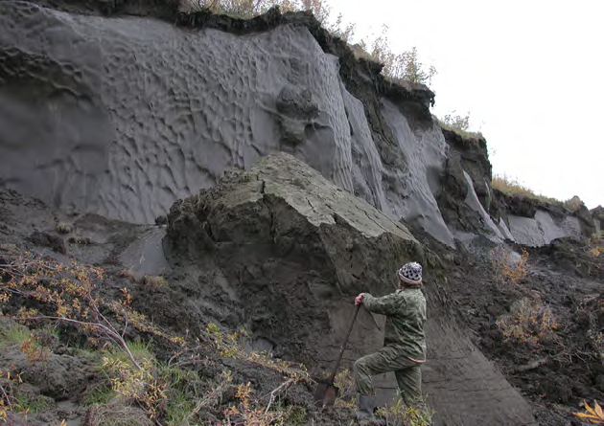
For Example…
PERMAFROST is Permanently Frozen… at least we thought so.

Slide 15
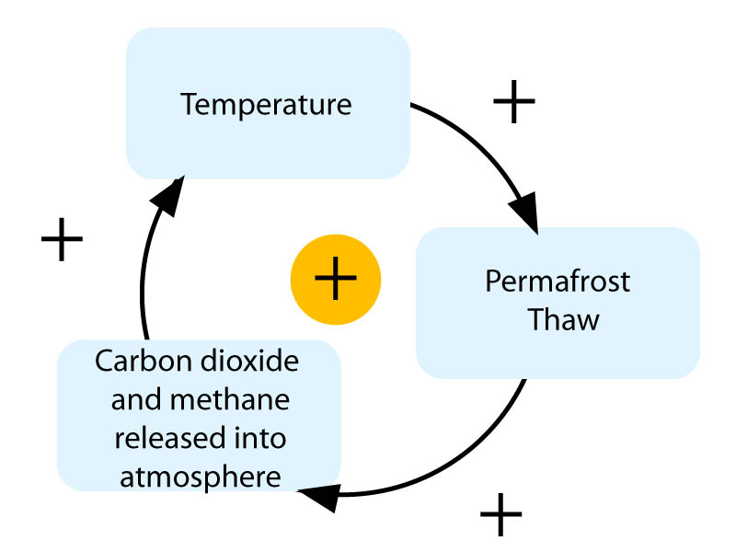
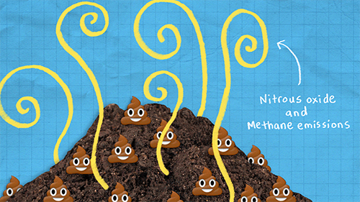

Slide 16
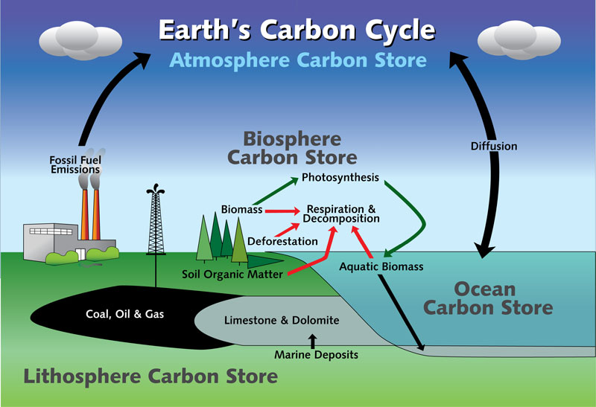
CO₂

Slide 17
Next…
Complete Methane and Global Temperature worksheet on your own paper.
Check your answers with Ms. B
Read Leaking Lakes Article.
Answer questions on the reading guide.
Check answers to the last page with Ms. B
Check your grades for missing assignments

