Slide 1
Greenhouse Gases and Energy Budget
Ms. Bankoff
Notes:
Day 1 Slides 2-9

Slide 2
Quiz
http://education.jlab.org/reading/energy_budget.html

Slide 3
Learning goals
What are greenhouse gases?
Where do they come from?
How do they work?
Notes:
DAY 1 KWL CHART
Over the next few days we will be investigating the different greenhouse gases and where they are from. Start with a KWL chart in order to determine what students already know.

Slide 4
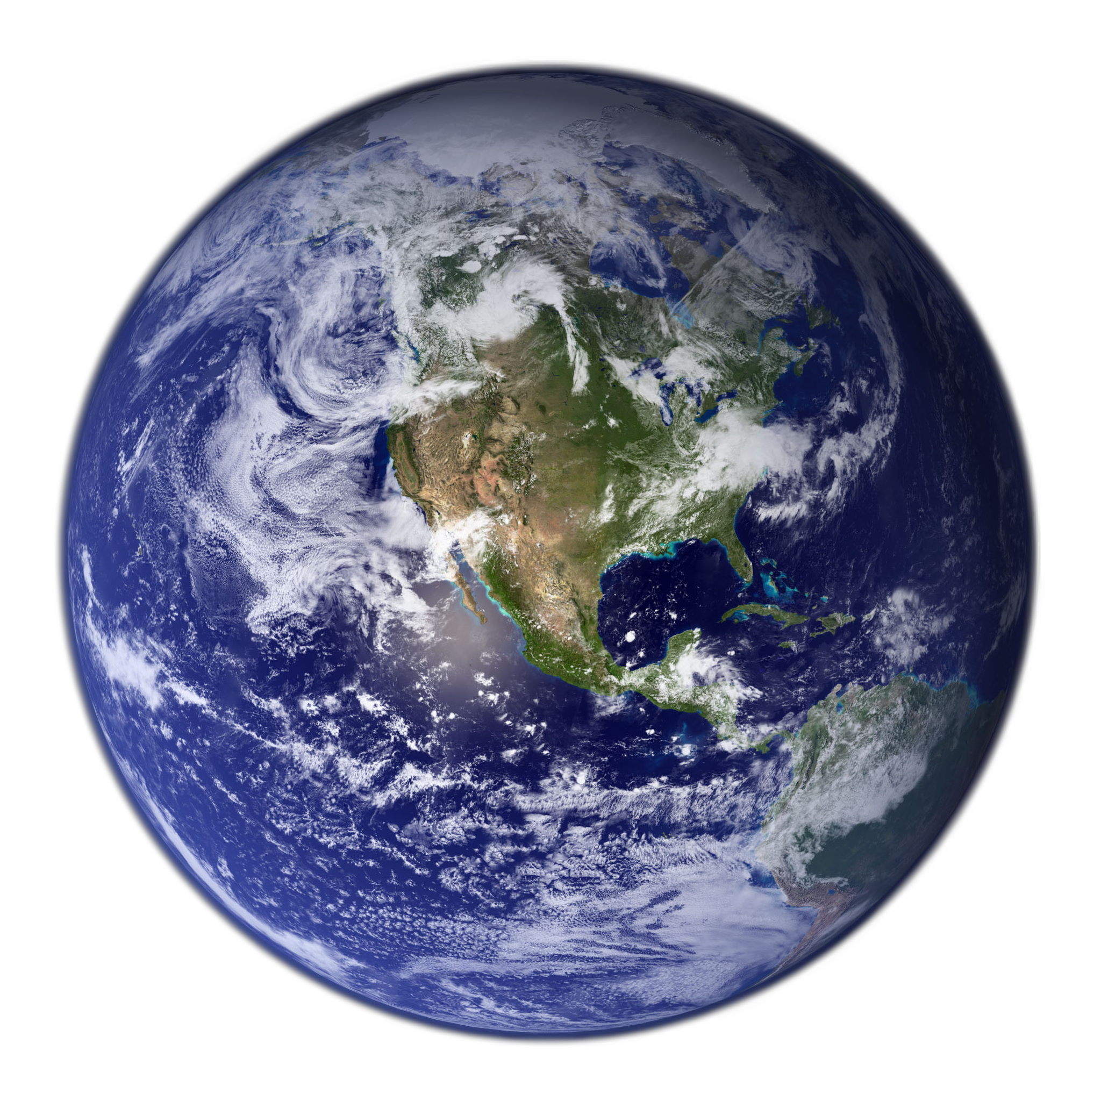
If the amount of energy that comes into Earth is the same amount of energy that goes out of Earth …
Hits earth
Reflected
how can our planet stay warm?

Slide 5
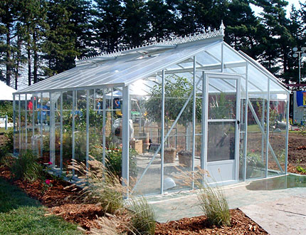
A greenhouse . . .
Notes:
A greenhouse in this definition is a house used to trap the sun’s energy in order to extend the growing season or grow plants in areas that would otherwise be too cold. We use this idea as a way to think about how sun’s energy is trapped in our atmosphere. The difference is that the Earth is not surrounded by glass, but by invisible gas that is also able to trap energy and heat.

Slide 6
What is the greenhouse effect?
Notes:
Students might also have experienced this feeling when they get into a car on a hot day. It feels much warmer inside the car because of the trapped air. So, it is different than the greenhouse effect but a connection to their experience. Students might be able come up with other examples as well.
Air in the car is trapped and can’t get out. On Earth, there is no physical boundary, so it is the gases that actually work to hold the heat. After these three slides students should be able to fill out the graphic organizer comparing and contrasting a greenhouse with the “greenhouse effect”

Slide 7
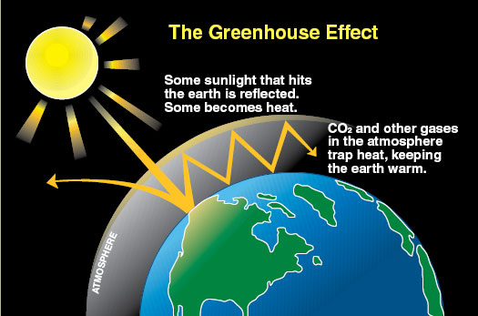
Notes:
Use this slide to relate back to and debrief the lab. What are the comparisons between the greenhouse gas lab and this picture?
Ask students for similarities and differences. There is space on their lab notes to write their comments.
Earth’s greenhouse effect
Some gases preferentially absorb certain wavelengths of radiation and are transparent to others. This is because of resonance. As we just saw with the amount of shaking in the gas models, they shake more or less depending on how much energy you put into them. The long wave radiation is the resonance wavelength of the greenhouse gases.

Slide 8
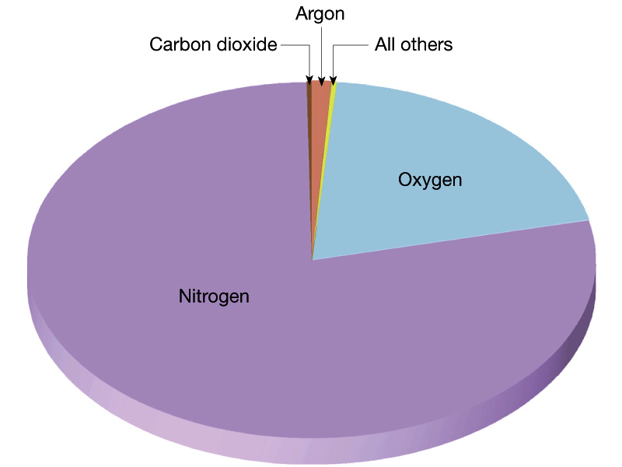
Composition of the Earth’s Atmosphere
Nitrogen N₂ = 78 %
Oxygen O₂ = 21 %
Argon Ar = 0.9 %
Other = <0.1%
Carbon Dioxide CO₂
Methane CH₄
Nitrous Oxide NO₂
Ozone O₃
Hydrogen
Notes:
DAY 1- RESONANCE MODELS
Most of our atmosphere is nitrogen and oxygen, neither of which is a greenhouse gas. Compare this to the Goldilocks effect. The greenhouse gases in our atmosphere are less than 0.1% of the total amount of gas in the atmosphere. Yet they are what make our planet inhabitable. Without the small amount of greenhouse gases, the average temperature on the planet would be 0 degrees F
There is a major misconception that the hole in the ozone layer is the primary reason for climate change. It is correct to say that the ozone hole has a small effect on climate change, but is not the main cause. The other connection between these issues is that Chlorofluorocarbons (CFCs) and their non-ozone-destroying replacements are very potent greenhouse gases, which also contribute to climate change. Students may or may not bring up these ideas in their discussion.

Slide 9
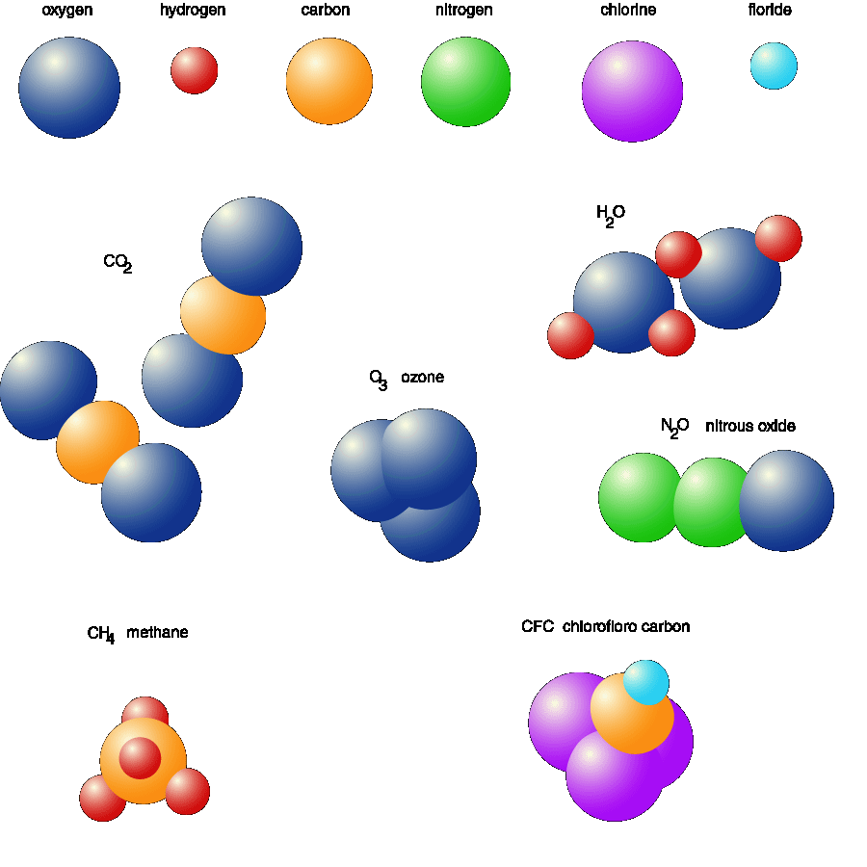
Greenhouse Gases
Carbon Dioxide
Water
Methane
Nitrous Oxide
Ozone
Notes:
RESONANCE MODELS- Show the tennis ball models of the gases
While this slide is up, students will complete the task card to use the models and discuss the following questions. Depending on your students it would also be possible to do this entirely as a demonstration.
Is there a frequency at which it is much easier to keep the model vibrating? At this frequency your model molecule better absorbs and retains your energy output. If there is such a frequency, determine what it is in vibrations per second by counting the number of vibrations in a 5-second interval and dividing by 5. Do at least three trials, letting different member of your group experiment and obtain the range of frequencies at which the maximum energy is absorbed. Repeat this procedure for all three models.
1. How do the resonant frequencies of the 3 models compare?
2. What hypothesis can you formulate to explain your observations?
3. Physicists tell us that the behavior of the models built from the tennis balls is a good analogy of the behavior of real molecules of carbon dioxide, methane, and nitrogen. From the observations of your models, can you explain why some gases in the atmosphere absorb infrared radiation and others do not?
4. Why do you think greenhouse gases absorb infrared radiation and do not absorb visible light?

Slide 10
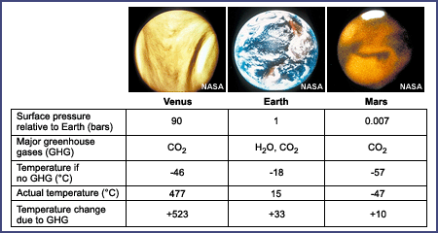
The “Goldilocks” Principle
Mars is too cold, Venus is too hot,
and Earth is just right!
Notes:
Why is the greenhouse effect so important? This slide compares the temperatures on three planets with and without greenhouse gases. All of them do experience warmer temperatures with the greenhouse gases. The next slide is specifically the Earth and temperatures are reported in Fahrenheit (which might be more familiar to the students).
Recent calculations by NASA actually put the temperature change due to GHGs at only 20 degrees, not the 33 degrees in the chart. This is mostly because of using a different albedo number to consider the effects of solar and longwave radiation on the planetary albedo. The changed number is (-18 to -5) and is called the “atmosphere effect” of greenhouse gases, as opposed to the “enhanced atmospheric test” associated by the increase in greenhouse gases due to human activities.

Slide 11
What if Earth did not have greenhouse gases?
Main Greenhouse Gases | CO₂ and H₂O
Estimated temperature without greenhouse gases | -5 °C (23 °F)
Actual average temperature | 15 °C (59 °F)
Temperature change because of greenhouse gases | 20 °C (36 °F)
Notes:
This is an example of why we want to have greenhouse gases. They make our planet inhabitable and bring the temperature up to a level humans can live in. It does not mean that the temperature everywhere on everyday is equal to 59 degrees, but just that there is a dramatic change because of the GHG. We know this because we can look at other planets (Mars and Venus usually) and compare their temperatures and atmospheres to ours.

Slide 12
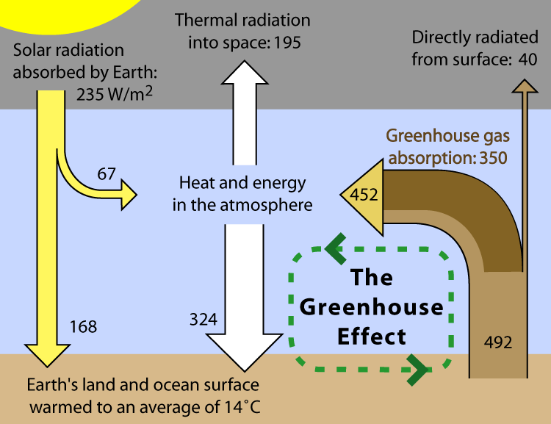
Notes:
This is a picture of the numbers that give us the greenhouse effect. This gives a more energy budget example of the previous picture. Explain that most of the solar irradiation reaching the lower atmosphere is visible light, but there are other wavelengths present as well. Some of the gases (including water vapor) in the atmosphere reflect incoming solar irradiation, some allow it to pass through to the Earth’s surface (where it is absorbed), and some absorb it.
The radiation (mostly visible light) that is absorbed in the atmosphere or by the Earth’s surface is re-emitted as long wave infrared energy (heat). When long wave radiation interacts with the atmosphere, different molecules will reflect, absorb, or allow it to pass through to space. Point out that the passing of long wave radiation from the Earth’s surface to the atmosphere, back to the Earth’s surface and so on is the fate of large quantities of solar irradiation and a major positive forcing. So the atmospheric gases that allow visible light to pass through but then absorb and re-emit long wave radiation are of huge interest to us (they can be thought of as like the car’s windshield), we call these “greenhouse gases” because they create a “greenhouse effect” in the Earth’s atmosphere.

Slide 13
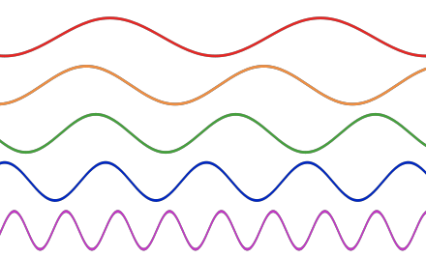
Frequency
Notes:
OPTIONAL:
This slide is not required. If you have time and inclination at this point, you could repeat the rope experiment from the other day. Students will see that different amounts of energy causes the rope to resonate at different frequencies.
BACKGROUND
Every object that is free to vibrate has its own natural frequency. If you vibrate an object near one of its natural frequencies, its motion may grow to quite large values, a process known as resonance. Molecules behave in the same manner: they absorb energy near their resonant frequencies and vibrate, creating heat. In this demonstration of model molecules of atmospheric gases, students can make observations about resonant frequencies.
Be care that the students do not confuse the wavelength of the radiation (long and short wave) with the resonance frequency, although they are closely related. A molecule moves at a certain frequency and it is a certain wavelength of light that is absorbed by a specific molecule.

