Slide 1
Windmill lab
2015

Slide 2
To do / today
Turn in Bubble Lab to the homework basket
Pick up graded podcast notes
Update Planner: See assignments board!
Answer this question
Today
Warm-up question
Read windmill article – review controlled experiments
Begin windmill lab
Homework: finish Questions 1-8 on Windmill Lab (includes procedures)

Slide 3
Think / Write / Share
On a new sheet of lined paper, write your thoughts:
Why was the Bubble Lab NOT a controlled experiment?

Slide 4
Goals
Students will design a controlled experiment to learn how to maximize the power of a windmill.
To learn about variables
Students will alter one variable in a windmill setup to see how it will affect its power.
To learn about controls
Students will keep all other variables constant in order to be certain that the independent variable is causing a change in its power.
To learn about Energy and Power
Students will learn to measure the energy and power output of a windmill.
Students will attempt to maximize the power output of a windmill.

Slide 5
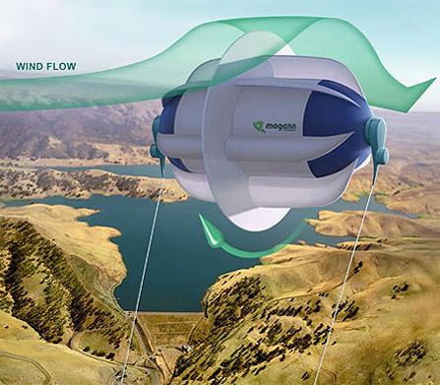
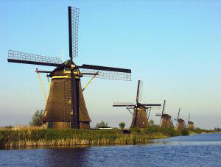
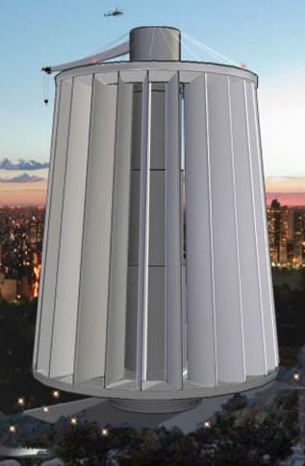
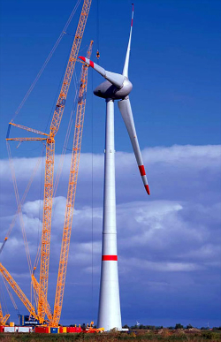
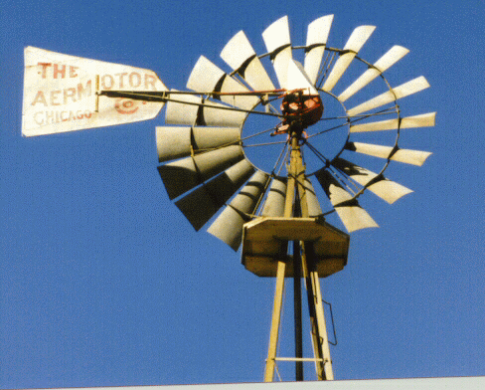
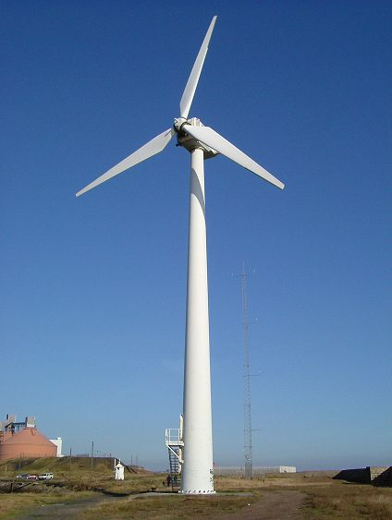

Slide 6
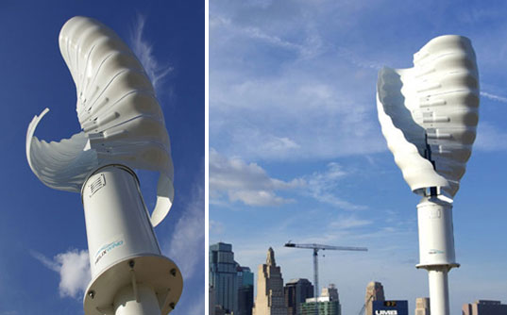
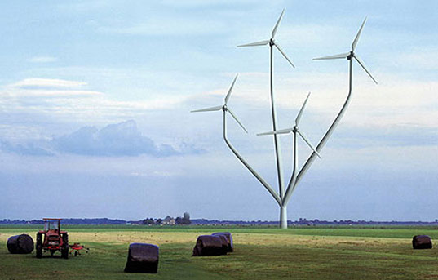
http://www.mywindpowersystem.com/2009/05/23/the-most-amazing-wind-turbines-designs/

Slide 7
Variables – what factors could affect the power of a windmill?

Slide 8
Dependent vs. Independent
Independent variable: __________________
Dependent variable: ____________________

Slide 9
Constants

Slide 10
Constants
Angle: 25 degrees
Length: 11 inches
# of blades: 4
Shape: 4.25x11inches (blue paper folded in half)
Distance from fan: 50 cm
Fan speed: high

Slide 11
Data
qualitative or quantitative?

Slide 12
Hypothesis
If
then
because .

Slide 13
Procedure (#8)
Be as SPECIFIC and CLEAR as possible when you write the plan.
Draw blade shapes you plan to test
What will you do first? Second? Etc.
Who will perform which tasks?
Include instructions on EVER constant (Items in your variables table)

Slide 14
Example Data Table m
Trial: Describe IDV | # of Washers lifted | Mass of washers (# x 14.5 ÷ 1000) (Kg) | Time to lift washers (Sec) | Power (W)
1.. Control Group
2..
3..
4..

Slide 15
Example Data Table
Trial: Describe IDV | Mass of washers lifted (grams) | Mass of washers lifted (kg) | Height (m) | Time to lift washers (Sec) | Energy (J) | Power (W)
1.______________ Control Group |  |  | 0.5 m
2.. |  |  | 0.5 m
3.. |  |  | 0.5 m
4.. |  |  | 0.5 m

Slide 16
10 Things to consider..
1 trial must be the standard setup (Control Group).
If the cup isn’t lifted to the top, it doesn’t count. Remove some washers from the cup.
Check the angle of the blades every trial.
Closer the blades are to the hub, the better!
Tape the crap out of the blades – wiggly blades aren’t awesome.
Don’t forget to time how long it takes to lift the washers.
Each washer has a mass of 14.5 g (average).
Decide who holds the fan right now – Noes Goes!
Every individual must have their own data table.
DIVIDE UP THE LABOR AND WORK QUICKLY OR YOU WILL NOT FINISH ON TIME.

Slide 17
Control Group set up
Angle: 25 degrees
Length: 11 inches
# of blades: 4
Shape: 4.25x11inches
Distance from fan: 50 cm
Fan speed: high

Slide 18
Symposium
The goal is for you to…
share your results with other groups
and to allow you to hear what other groups discovered during their experiments.
Help yourself/peers learn about the strongest windmill design.
Link to real life:
Engineering firms and research universities like CU host symposiums periodically to share new information with other people in their field.
“No man is an island.” – John Donne
“If I have seen further it is by standing on the shoulders of giants.” – Sir Isaac Newton

Slide 19
Symposium
Design | # of Washers Lifted | Seconds | Power
1..
2..
3..
Design | Max # of washers lifted | Seconds | Power
What were the challenges you encountered when testing the windmills?
How did you overcome them ?
What advice you can offer to fellow students when creating a windmill?

Slide 20
Symposium – Block 4
Design | Mass of washers lifted | Seconds | Power
1..
2..
3..
4..
5.. |  |  | .133 W
6.. |  |  | .087 W
7..

Slide 21
Block 4
group | # of washers lifted | Seconds | Power
1..
2..
3..
4..
5..
6..
7..

Slide 22
Cleanup Instructions
Remove blades from the hub
Remove wooden pegs from blades (including tape)
Put all equipment away
Save blades that are special shapes in your class’s drawer or box.
Put fan and windmill base where Ms. Bankoff indicates.

Slide 23
Challenge Day
Activities:
Windmill challenge (25-30 minutes)
Review for quiz next class.
Discuss homework (podcast)
Goal:
Make the strongest windmill!
To utilize the information we gained from controlled experiments.

